Slide 1
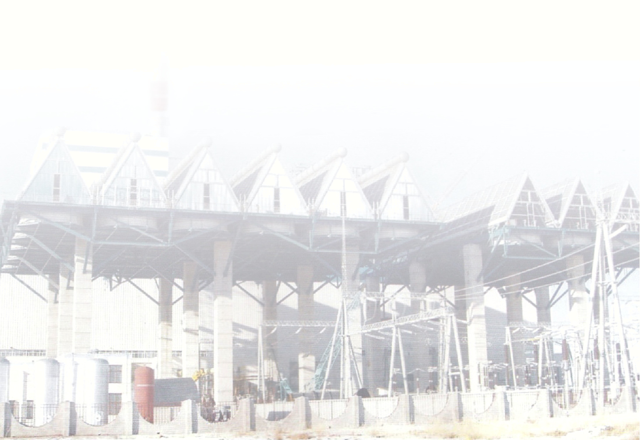
A
Project Report
On
“Air-Cooled Condenser”
(With a case study on Power & Blowing Station ,SAIL- BSP)
In partial fulfilment of 8th semester
BACHELOR OF TECHNOLOGY
In
MECHANICAL ENGINEERING
By
Anand Kishor
Anurag Mishra
Govind Kumar Pandey
&
Manoj Kumar Gupta

Slide 2
Declaration
We solemnly declare the report of the project entitled, “Air-Cooled Condenser” is based on our own work carried out during our visit at Power and Blowing station(PBS) of SAIL, BSP under the supervision of Mr. V.S. Dewangan { AGM, Turbine}.
We assert that the statements made and conclusions drawn are the outcome of our project work. We further declare that to best of our knowledge and belief the report does not contain any part of any work which has been submitted for the award of any other degree in any other university.
Anand Kishor
Anurag Mishra
Govind Kumar Pandey
Manoj Kumar Gupta
B.Tech (Mech.), 8th Sem.
ITGGU, Bilaspur (CG)

Slide 3
Certificate
This is to certify that the report of the project submitted is the outcome of the project-work entitled “Air-Cooled Condenser” carried out by Anand Kishor, Anurag Mishra, Govind Kumar Pandey & Manoj Kumar Gupta pursuing B.Tech (Mech.) at ITGGU, Bilaspur, under my guidance and supervision.
To the best of my knowledge the report :-
Embodies the work of the candidates themselves.
Has duly been completed.
Is up to the desire standard for the purpose for which it is submitted.
_________________
Mr. V.S. Dewangan,
AGM (Tubine)
Power & Blowing Station
SAIL, BSP

Slide 4
ACKNOWLEDGEMENT
We would like to take this opportunity to express our profound sense of gratitude and respect to all, who helped us to complete the project.
First and foremost, we would like to thank Mr. V.S. Dewangan {AGM, Turbine} for his constant encouragement and support throughout the project. Our project at Power and Blowing Station {SAIL-BSP, BHILAI} has been a useful and enlightening experience.
We also express our thanks to Mr. Seikh Zakir {AGM, P&BS} .We pay our regards to all the employees of P&BS{SAIL-BSP, BHILAI}.
We express our heartiest thanks to Prof. P.C. Upadhyay, Mechanical Engineering Department, ITGGU who inspired, guided and helped us in the completion of our project.
Duration
(02-28) june, 2012

Slide 5
Abstract
Air-cooled condenser adopts air as cooling medium in-order to condense the exhaust steam at the outlet of turbine; it’s a close circulatory system in which air cooled radiators are equipped with dry cooling tower or mechanical draft equipment. The utilization of air-cooled condensing system can save a great amount of make-up cooling water, which can facilitate a huge savings in terms of capital as well as the most valuable resource i.e. water.
The same savings have been exhaustively studied for indirect air cooling system condenser with direct contact in the context of Power & Blowing station 1 & 2. The case study depicts that for P&BS 1, the total savings in terms of capital is 95.69 million rupees per year, and in terms of water the saving is 12.93 million M³ per year; and for P&BS 2 the total capital saved is 129.13 million rupees per year and the water saved is 4.86 million M³ per year!!
Air-cooled condensing system can also facilitate the installation of power plants in the regions, where there is a lack of water.
The air-cooled condenser applied in power plant can be divided as:-
Indirect Air Cooling System with Direct Contact Condenser
Indirect Air Cooling System with Surface Contact Condenser
Direct Air Cooling System
In our project we have basically studied the installation of Indirect Air Cooling System with Direct contact condenser at P&BS , SAIL-BSP as it suits the local environment there because of its features like no necessity of big inside diameter, easy arrangement, air cooling tower can be far away from the plant, small condenser. The water pressure of cooling components in the air cooling tower being higher than atmospheric pressure owing to using high pressure-head circulating water pump, air will not leak into the condensate system. In this system , the turbine average back pressure is lower than the Direct Air Cooling Unit, slightly lower than the Surface type Air-cooling system, therefore unit is economical and has low specific fuel consumption.

Slide 6
Contents:-
Introduction.
P&BS-1 & PP-2 at a glance.
Basic power plant operations & importance of condenser.
Advantages of Air-Cooled Steam Condenser unit over traditional Water-Cooled Condenser unit.
Identifying steam condenser problems.
Design and Specification of Air-Cooled Steam Condensers.
Case study for installation of Indirect Air Cooling System with Direct Contact Condenser unit at P&BS-1 and PP-2.
Guidelines to avoid “Design Deficiencies”.
Thermal Specification & Cold Climate Considerations.
Check points for safe design.
Conclusion.
References.

Slide 7
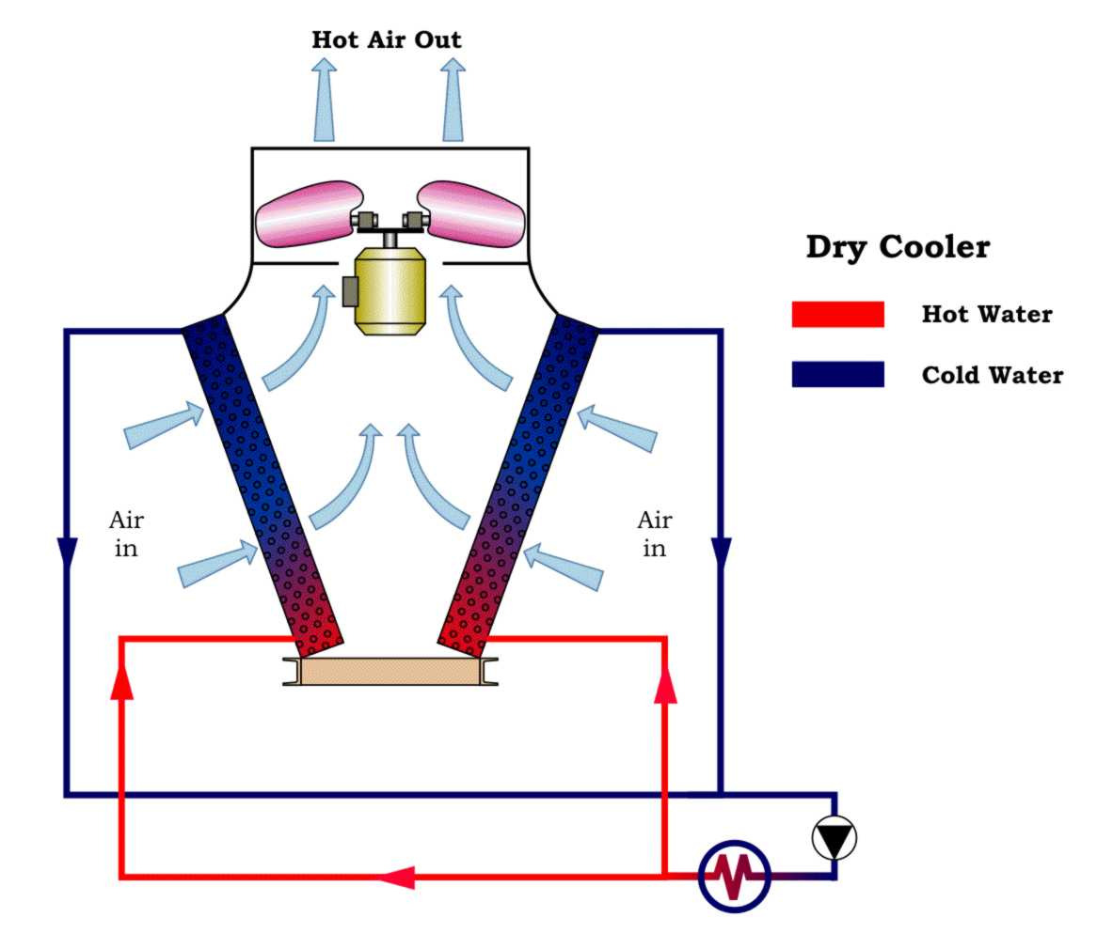
Introduction
Air-cooled Condenser is basically an air cooled heat exchanger, which rejects heat from a process cooling medium to the surrounding atmosphere by means of dry cooling i.e. convective heat transfer with the aid of air. There are basically three types of air-cooled condensers and the operating mode is dependent mainly upon the heat load and ambient conditions.
The process cooling medium generally water or a water glycol mixture, flows inside the horizontal tubes of finned tube heat exchanger bundles arranged in a V or A- shape Vertical configuration. Water inside the tubes is cooled by the ambient air being sucked by fans on the top of air cooler, as depicted in the figure below.

Slide 8
The power plants’ air-cooled condenser systems can broadly be divided into two major types; they are “direct air-cooling system” and “indirect air-cooling system”. “Indirect air-cooling system can further be divided into two categories; “direct contact condenser” and “surface contact condenser”:-
Indirect Air cooling System with Direct Contact Condenser
The principle of the system is that the exhaust steam from the turbine in the jet condenser comes in direct contact of the cooling water from the nozzle; the water then absorbs the latent heat of vaporization of the exhaust steam and the exhaust steam condenses to water. Then the majority of cooling water, at elevated temperature, is delivered to the air-cooled radiator in the air cooling tower by circulating water pump, after being cooled by the air, it goes to “direct contact condenser” for circular uses. A small part of the heated cooling water about 2%~5% is delivered to the boiler as make-up water , after the processing of condensate water equipment. The Air-cooling radiators is made of aluminium finned tubes or galvanized steel tubes.
The structural features are:-
No necessity of big inside diameter exhaust pipe.
Easy arrangement.
Air cooling tower can be installed far away from the plant.
The endothermic end of the condenser may be kept small as per requirement.
The water of the cooling components in the air cooling tower being higher than the atmospheric pressure owing to using high-pressure head circulating water pimp , will not leak into the condensate system.
The system’s turbine average back pressure is lower than the “direct air cooling unit “, slightly lower than ‘”surface type air cooling system, hence the unit is economical and has least fuel consumption.

Slide 9
Indirect Air-Cooling system with Surface condenser
Surface type indirect air cooling system uses surface condenser to replace direct contact condenser in order to simplify the system. The circulating water pump of surface condenser is same as common wet cooling unit, but for the cooling part it applies air cooling tower in place of wet cooling tower, chemically treated soft water instead of recycled water, closed circulating cooling water system in place of open circulating cooling water system. Air cooling system requires expansion tank, it’s function is to adjust the cooling water volume which is affected by temperature change, maintenance of pressure head of the entire circulating water. The air cooling system radiator is made of galvanized steel finned tubes and aluminium finned tubes.
The system’s shortcomings are:-
Cooling tower occupies large area.
Higher investment in infrastructure.
The two heat exchanging processes, i.e. between ‘exhaust steam and the cooling water’ and ‘the heated water and air’, are of surface type and require large heat transfer end, hence the thermal efficiency of the power plant becomes low as compared to direct contact type condenser.

Slide 10
Direct Air Cooling System
In direct air cooling system also called ACC system, the exhaust steam from the turbine directly enters into the outdoor air-cooled condenser through exhaust steam pipe. The axial fan blows air from the atmosphere , thus condensing the steam into water. The condensate water is then pumped through the condensate treatment equipment back to the boiler make up water system by the condensate pump. A number of parallel galvanized steel finned tubes as cooling components comprises the air cooled condenser. The air cooling tower is generally arranged on the roof of steam turbine room, usually adopting mechanical draft for cooling.
Direct air cooling system is characterized by:-
Less equipment requirement.
Simple system.
Flexible adjustment of air volume.
Efficient heat transfer due to high temperature difference between the exhaust steam and the cooling components.
However, because of big diameter exhaust pipe of such system, vacuum system becomes bulky, so, its difficult to seal and easy for air infiltration.
It is difficult to maintain vacuum in the exhaust pipe and it needs a long time to reach vacuum when started and hence the mechanical draft system requires higher power for proper operation.
Our study revealed that Indirect Air cooling System with Direct Contact Condenser is best suited to be installed at P&BS of SAIL-BSP, hence we have carried out a case study for the same.

Slide 11
P&BS-1 & PP-2 At A Glance
Power & Blowing Station is a vital installation. It serves the following needs of the Bhilai Steel Plant.
Supplying air blast to Blast furnaces at requisite parameters.
Meeting emergency power requirements of the 2.5 MT units of Bhilai Steel Plant in case of any grid power failure and also to generate power to reduce dependency on bought out power and save costs.
Meeting the process steam needs of various shops for their safe/efficient operation.
Buffer consumer of available Blast furnace and coke oven gasses to prevent their wastage/high pressure in the gas line network.
As such the shop is required to be run at a high level of efficiency and reliability to ensure that working of other shops particularly Blast furnace are not effected.
Power & Blowing Station has the following sections:-
Water chemical treatment plant - capacity 325 T/Hr.
Coal handling plant - 90 T/Hr.
Boiler house - 6Boilers 150 T/Hr at
450⁰ C & 39 atm .
6th boiler is equipped with double drum, regenerative
type rotary air preheater and E.S.P.
Turbine Hall - 3 Generator 12 MW each & 9 Blowers
3Blowers – 10 MW equivalent capacity
4Blowers – 12 MW equivalent capacity
2Blowers – 19.82 MW equivalent capacity
Electrical control room & switch gears.

Slide 12
Water Chemical Treatment Plant
Raw water from reservoirs at Maroda is required to be treated before it can be used in boilers. The process of softening raw water is shown below.
Raw water
Suspended impurities
>20 PPM
Pumped with water pump 2nos. 410 t/hr each
Clanfier
Alum solution : 100
Added for coagulation
Removes suspended /
Mechanical impurities
Coagulated
Water tank
100 Ton capacity
Mechanical
Filter. Double
Flow. Sand bed
Cap. 90 T/Hr. 6 nos.
Coagulate-d
Water pump
Second stage
Softener Buffer
Cat-ion exchanger strong acid
Exchanges resin in to sodium here water contains cation Ca++ & Mg++ in the form of MgCl2 , Mg(Hco3)2 CaCl2 Ca(Hco3)2 , CaSo4 , MgSo4
Cat-ion
Water
ECS of Open Hearth
To PBS boiler

Slide 13
R(Resin) + Na₂ + Ca(HCO₃)₂ = CaR + 2 NaHCO₃
R(Resin) + Na₂ + CaCl₂ = CaR + 2 NaCl
Regeneration is done to get back Na ions.
Coal Handling Plant
Power & Blowing Station receives Boiler coal of “C” grade from Banki/Surakachar, Katkona and South Eastern collieries its captive coal handling plant in railway wagons and unloaded at slot bunker having capacity of 300 T, by manual lab our. The bigger size coal and coal in defective wagons unloaded on line 41 A of augmenting the coal un loading to release railway wagons to avoid demurrage. The coal received from mines has the following properties:-
1) U.H.V. - 5000 – 5600 K cal/Kg
2) Ash content - 18 to 25 %
3) Volatile matter - 21 – 23 %
4) Moisture - 7 – 20 %
The capacity of coal storage yard at PBS is 20000 Tones.
The coal unloaded at slot bunker is conveyed to boiler bunkers through a series of single strand conveyers. The coal is crushed into a crusher having a capacity of 90 T/Hr. to the size of 25 mm. The conveyors are also having the coal carrying capacity of 90 T/Hr. There are 6 conveyors in all. The crushed coal is first stored in the coal yard and then led boiler bunkers as per requirement.

Slide 14
Boiler House
There are five boiler type T 17 – 150 – 2 Russian make and one new boiler of ISGEC john Thompson Pvt.Ltd. The Russian make boiler are water tube, radiant, natural circulation, single drum bottom supported vertical boilers intended for generating superheated steam of 150 T/Hr. at drum pressure of 44 atm and temperature of 450⁰C.
The ISGEC john Thompson boiler is having same specification (Boiler is British make) except that it is having dual drum, direct firing system, an electrostatic precipitator and rotary air preheater.
Originally all the five Russian boiler were having wet ash collector system (scrubbers). The programme for changing it to ESP carried out. Now Boiler 1,2 & 5 have ESP working.
The principal data of boilers are as follows:-
Properties | Boiler-1-5 | Boiler-6
Rated capacity | 150 TPH | 150 TPH
Working Pressure at Drum | 44 atm. | 44 atm.
Feed-water temp. | 150°c | 150°c
Superheated Steam Temperature | 450°c | 450°c
Working pressure at MSV | 39 atm. | 39 atm.
Radiant surface area of Tubes | 601m² | ---------------
Total heating surface | 3326m² | 3679m²

Slide 15
The pulverized coal burners (6 nos.) are fed by primary air, Burners are located on side walls. Six PCM burners are fixed concentric with coal dust burners. B.F. gas burners (6 nos.) are located below coal dust burners. Co gas burners (4 nos.) are on front wall.
Coal dust preparation system :
Raw coal from raw coal bunker of boiler is fed to ball mill through raw coal feeder for crushing into powdery form. Here a combination of cold air, warm air & Hot air is used to maintain an out let temperature of 65⁰C. The air is used as carrier of coal dust. The air-dust mixture is than passed through separator where bigger particles of coal are separated and fed back to Ball mill for crushing again. The powdery coal dust and air are then passed through cyclone where coal dust and air are separated. The coal dust gets accumulated in coal dust bunker and air is used to carry coal dust from bunker into boiler furnace for burning. The capacity of Ball mill is 16 T/hr. The designed efficiency of the boiler is 85.18 % to 90.5 % depending upon the type of fuel used and their combination.
Drum : Drum is designed for 2 stage evaporation. It is divided into 3 compartments with one central compartment having clear water and 2 side compartment know as salt compartments.
Feed water from economizer enters into clear compartment.
Steam takes off from the clear compartment, passes through 2nd stage super heater coil (with respect to flue gasses passage) to attemperator where pure condensate is mixed to control steam temperature, steam further goes through 1st stage superheater coil (w.r.t. flue gas flow) and then goes to steam collector through main steam valve.

Slide 16
Economizer :-
There is 4 stage economizer placed in the flue track where feed water enters at 150⁰ C and after heating by flue gas, goes to clean compartment of the drum.
Air Preheater :-
The air preheater is of Tubular type and has two stages placed in the flue gas passage after the economizer to get warm and hot air for Ball mill secondary air for combustion. The cold air is supplied by F.D. Fans.
Scrubber :-
The dust laden gasses after preheater are passed through scrubber where water is sprinkled on the gases through nozzles and dust is removed. The dust free gases are then sucked by induced draft fans are led to atmosphere through chimney.
E S P :-
The electrostatic precipitator installed in boiler No. 6 and are installed for boilers 1,2 & 5 efficiently removes the dust from gases to maintain environment norms.(150 Mg/m³)
Ash handling system :-
This unit of Power & Blowing Station is most critical. The slurry formed in the scrubbers and ESPs is led to Ash handling pumps through tunnel to pump it out through ash slurry pipeline.

Slide 17
TURBINE HALL
There are 3 turbo generators of 12 MW each and 9 blowers to supply uninterrupted air blast to 7 blast furnaces.
Turbine of Turbo generators 1 & 2 is single cylinder, 15 stage, condensing, impulse reaction type with Curtis wheel. The rotor is directly coupled to generator by means of semi flexible coupling. The turbine has a normal speed of 3000 RPM and has 4 pass outs of steam i.e. bleeder, 2 regulable and 2 non-regulable. The regulable bleeder supply steam at 8 – 13 atm at 246⁰ C and 1.2 – 2.5 atm at 145⁰ C for process steam and for dearators.
The nonregulable bleeder supply steam to H.P. & L.P. heaters.
The turbine to turbo blowers are of single cylinder, 12 stage, condensing type directly coupled with compressor by means of flexible geared coupling and provided with 2 non-regulable bleeders for regenerative system.
3 compressors of 1.0 M.T stage are single cylinder centrifugal type, with an intermediate air cooling system after 2nd stage.
4 compressors of 2.5 M.T stage are double cylinder centrifugal type, with inter cooling system, 2 nos. 4 M.T blowers are of axial type single cylinder without inter cooling.
The turbines are equipped with hydro-dynamic system & speed regulators, in this system the impulse is proportional to the square of velocity of rotor.

Slide 18
Auxiliaries :-
1.Condenser: Each turbine has one surface type of condenser with separate 2-pass water flow. This type of design permits cleaning of turbine condenser in halves in succession without stopping the turbine but working with reduced load.
2.Condensate pumps: There are 2 Nos. condensate pumps of 60 T capacity each to extract condensate from the condenser.
3.Oil tanks: Oil required for lubrication of bearing and regulation system is filled in these tanks. The main oil pump is mounted on the shaft of the turbine and supplies lubrication oil & regulation oil through injectors. Oil cooler are installed to cool the oil.
4.Oil pumps : There is a main pump mounted on main shaft of turbine which supplies oil for lubrication and regulation purposes. There is an emergency oil pump which starts automatically when the oil pressure goes below predetermined pressure and supplies oil for lubrication purposes. One Auxiliary oil pump is there during the starting 2 stopping to take over M.O.P. supply.
5.Ejector : As the condenser is a vacuum type so while starting the turbine it is necessary to produce vacuum in the condenser and to maintain it turbine is running. It is a two stage ejector.
6.Deaerators : Desecrators are the vessels where dissolved oxygen in the condensate and chemically treated water is removed, as oxygen is corrosive. The desecrators are of atmospheric type and works at a steam pressure of 1.7 atm abs. And water temperature at about 103⁰C to 105⁰C. The desecrated water is then sent to boiler economizers through feed pumps. There are 6 nos. desecrator in all.

Slide 19
Main Control Room & Switch Gears
Out of 225 MW maximum demand of Bhilai Steel Plant, Power & Blowing Station shares 36 MW with 3 generators in operation. This power plant is connected to MPEB grid through 2 Nos. tie Lines. It feeds the following vital consumers apart from supplying its own auxiliaries.
1. Cock Ovens
2. Blast Furnaces 1 to 6.
3. Sintering Plant – 1.
4. Open Hearth Furnaces
5. Pump Houses Furnaces
6. Oxygen Plant – 1.
Main features of electrical installation are depicted below:
1.Generators :- 3 Nos. capacity – 12 MW each, 50 Hertz 6.9 KV, 3000 RPM, exciter – 75 KW with AVR (magnetic amplifier type) with field forcing.
Protection : Differential, overload with minimum voltage blocking, earth fault in stator and double earth fault in rotor.
2. Reactors : Concrete type – 15 Nos.
3. Main switch gears : 6.9 KV, 1500 Amps, fault level 500 MVA with cross jet are extension type, double pole per phase Russian make oil circuit breakers.
4. Auxiliary switch gears : 6.6 KV, 600 Amps, fault level 200 MVA with cross jet are extension type (oil circuit breakers -–69 Nos.) for B.6 – MOCBs are 1200 Amp fault level 250 MVA.

Slide 20
5. Air circuit breakers : 400 V, motor operated.
6. Auxiliary Transformers:
560 KVA 6.6 / 0.4 KV Y/Y – 6 Nos
630 KVA 6.6 / 0.4 KV Y/Y – 5 Nos
7. H.T. motor (6.6 KV) 49 Nos.
8. L T. motors (400 V) 1600 Nos.
9. Station Battery – 660 AH 130 Cells
10. Lighting points – 6000
11. Tie line :– 10 MW capacity and protection differential, Bus bar, under frequency.
12.Auxiliary feeders: – 3 Nos. with differential and over load protection.
SAFETY :-
Power & Blowing Station is a hazardous area. Blast furnace gas, Cock oven gas and hot PCM are used as fuels, so much so these lines run around and inside the shop. High pressure and Low pressure Steam Line & Water Line network engulfs the entire shop. Coal dust is also a potential fire hazard. There are H.T and L.T electrical installation and cables.
All in all Power & Blowing Station is a high hazardous area and all new entrants are strongly advised to understand the safety hazards before entering the shop.

Slide 21
POWER & BLOWING STATION 1 STEAM RAISING CAPACITY – 900 T/HR. POWER GENERATION CAPACITY – 36 MW DETAIL OF EQUIPMENTS
Turbo Generators (4 nos.): total capacity 51 MW
EQUI-PMEN-T | TURB-INE TYPE | QTY. INSTALLED | CAPA-CITY | SPEE-D (RPM) | YEAR OF MANUFACTURE | STEA-M PRES-S-URE / STEA-M TEM-P. | REGU-LABL-E BLEE--DER | DATE OF COMI-SSIONI-NG | MANUF-ACTUR-ER
TG-1 & TG-2 | APT-12-1 | 2 nos. | 12 MW | 3000 | 1957 | 35 ata 435º C | a) 1.2 - 2.5 ata : 1 no. b) 8 - 13 ata : 1 no. | a) TG-1 : 4.6.1959 b) TG-2 : 25.1.1959 | Bayausk Locomoti-ve Plant no. 5710, Ministry of Transport M/C building, USSR Poltavski Turbo Mechanic-al Plant Ukraine
TG – 0 | K-12-35T | 1 no. | 12 MW | 3000 | 1957 | 35 ata/ 435º C | NIL | 12.11.1964 | Kaluga Turbine Plant no. 8703, USSR

Slide 22
TG-03 | _ | 1 no. | 15MW | 3000 | ____ | 35 ata/ 435º C | ____ | 25.9.2006 | ____
Turbo Blowers (total installed 9 nos.)
EQUIPMENT | TYPE TURBINE ; BLOWER | QTY INSTALLED | CAPACITY | MAX SPEED (RPM) | STEAM PRESSURE / STEAM TEMP. | DESIGN OUTPUT AT NTP | YEAR OF MANUFACTURE | DATE OF COMMISSIONING | MANUFACTURER
TB-4,5 | AKB-12-II ; K-3250-41-1 | 3 nos. | 10 MW | 3250 | 35 ata/ 435º C | 2400 NM³/ min at Pr. 2.6 Kg/cm² (g) | 1957 | TB-3 : 25.1.1959 TB-4 : 25.1.1959 TB-5 : 17.12.1959 | Nevsky Lenin machine Building Works, Leningrad
TB-6 | AKB-12-V ; K-3250-41-1 | 1 no. | 12 MW | 3250 | 35 ata/ 435º C | 2400 NM³ / min at Pr. 2.6 Kg/cm² (g) | Turbine : 1970 Blower : 1957 | 29.12.1959 | - Do -
TB-7,8,9,10 | AKB-12-IV ; K-4250-41-2 | 4 nos. | 12.5 MW | 3400 | 35 ata/ 435º C | 2700 NM³/ min at Pr. 2.6 Kg/cm² (g) | TB-7 : 1963 TB-8 : 1964 TB-9 : 1965 TB-10 : 1966 | TB-7 : 24.11.1964 TB-8 : 11.5.1966 TB-9 : 14.2.1970 TB-10 : 16.12.1970 | - Do -
TB-11 | NK-50/71-3 ; AGR 9/13 T2, SL. NO. 5348 | 1 no. | 16.09 MW | 4770 | 35 ata/ 435º C | 4200 NM³/min at Pr. 3.7 Kg/cm² (g) | - | 14.09.1987 | Turbine : BHEL Blower : GHH, Germany
TB-12 | NK-50/71-3 ; AG 090 / 13R SL. NO.5741 | 1 no. | 16.349 MW | 4770 | 35 ata/ 435º C | 4200 NM³/min at Pr. 3.7 Kg/cm² (g) | - | 12-04-2000 | Turbine : BHEL Blower : GHH, Germany

Slide 23
USSR BOILERS
Type : -Total 5 nos., type ; T-150-2, TKZ make, single drum, natural circulation, balanced draught, radiation type, vertical water tubes, combination fuel firing boilers.
Capacity :
Evaporation capacity : 150 TPH at 44 kg/cm²
of drum pressure.
Super heated steam temperature : 450 ⁰ C
Feed water inlet temperature : 150 ⁰ C
Feed water pressure : 60 kg/cm²
Furnace volume :970 M³
Total heating surface : 3326 M²
Safety valves:
Qty. : 4 Nos. on each boiler
Blowing capacity/S.V. : 38 TPH
a) Boiler 1,2 & 3 : All safety valves are mounted on the super heated steam collector manifold, and pilot steam lines are also taken from the manifold (2 per impulse lines from drum and 2 per impulse line from manifold). Therefore the rated working pressure for these valves is 39 kg/cm² .
Setting : For opening contact : 39+(3 to 5) % .
For closing contact : about 2 to 2.5 kg/cm² below opening contact, i.e. about 5% less than opening value.
b) Boiler 4 & 5 : All safety valves are mounted on the super heated steam collector manifold. Impulses for SV 1 & 4 are taken from the manifold but for SV 2 & 3 impulses are from the drum.
Setting: Procedure is same as Boiler 1,2 & 3. But for SV 1 & 4 pressure is 39 kg/cm² and for SV 2 & 3 it is 44 kg/cm² .

Slide 24
Boiler drum :
Outside diameter : 1755 mm
Wall Thickness : 55 mm
Length : 11.2 meters
3 compartments : 1 clean + 2 salt
Water wall tubes
1) Front wall : 101 Nos
Rear wall : 101 Nos
Right side wall : 94 Nos
Left side wall : 94 Nos
Total : 390 Nos
2) O.D. = 60 mm, thickness = 3.5 mm, Material : SA 210 GR A1
3) Water velocity : 1.36 M/sec
4) Gas velocity in convection bank : 6.5 M/sec.
5) Heating surface : 601 M² radiation
110 M² convection bank. Super heater Stage-I
OD : 38 mm
Thickness : 3.5 mm
No of coils : 71
Material : SA 213 T11
Heating surface : 355 M²
Steam velocity : 20 M/sec
Gas velocity : 8.55 M/sec
Super heater Stage-II
OD : 42 mm
Thickness : 3.5 mm

Slide 25
No of coils : 71
Material : SA 213 T11
Heating surface : 355 M²
Steam velocity : 20 M/sec
Gas velocity : 8.55 M/sec
Super heater Stage-II
OD : 42 mm
Thickness : 3.5 mm
No of coils : 72
Material : SA 213 T22
Heating surface : 570 M²
Steam velocity : 20.6 M/sec
Gas velocity : 8.2 M/sec.
Economizer
No. of stages :4 stages
OD : 32 mm
Thickness : 3 mm
Material : SA 210 GR A1, SA 213 T11
Heating surface : 1690 M²
Gas velocity : 8.8 M/sec
Air pre heater
Type :Tubular
Stage-I : OD = 40 mm, thickness = 1.5 mm, Mat: St-20
Stage-II : OD = 40 mm, thickness = 2 mm, Mat: St-20
Air velocity in APH : 6.3 M/sec
Heating surface :7360 M²
(counter flow)

Slide 26
Soot Blowers
Capacity (steam) : 6 T/hr.
Total qty. : 26 Nos. on each boiler
Radiation zone, short retractable type : 20 Nos.
Super heater zone, long non-retractable type : 6 Nos.
Radiation zone
Type (a) : length L = 355 mm
Type (b) : length L= 315 mm
Type (c) : length L= 295 mm
Super heater zone
Type (a) : length L=3744 mm
Type (b) : length L=3874 mm
Ball Mills :-
Qty. : Total 5 nos
Type : Drum mill
Drum inside dia. : 2870 mm
Inside length : 4700 mm
Mill output : 16 T/Hr.
Rated RPM : 18.75
Power consumption : 500 Kw
Max. Wt. Of steel balls : 35 T
Ball dia. : 40 mm
Mill liner : 14% Mn Steel
Drive motor : 570 Kw,745 RPM, 6.6 KV( B-1,2,5) , 480Kw,600 RPM, 6.6 KV (B-3,4)
Mill differential : 90-100 mm WC

Slide 27
Separator and Cyclone
Separator Type : Ordinary baffle type
Adjustment of fineness : By adjusting the baffles
No. / boiler : 1 no.
Cyclone type : Ordinary tangential entry type
Operation : Under negative pressure.
Coal Dust Feeder
Type : Blade type
Max Capacity : 5 T/Hr. for wheel dia. 155 mm
3.5 T/Hr. for wheel dia. 190 mm
Motor capacity : 0.9 KW
RPM : Max 1350, Min 450
Qty. per boiler : 6 nos.
Ash Slurry Pumps
Qty. : 8 nos.
Streams : 4 ; each stream contains 2 pumps in series
Capacity : 300 Cu. M / Hr.
Pressure : 45 M WC
RPM : 985
BURNERS :-
Coal dust burners : Total 6 Nos. per boiler, 3 Nos. on each side wall.
BF gas burners : Total 6 Nos. per boiler, 3 Nos. on each side wall.
CO gas burners : Total 4 Nos. per boiler on front wall,
capacity of each burner:-2500 M³/Hr.
Oil burners : Total 6 Nos. per boiler, These are concentric * to Coal dust burners.

Slide 28
SCRUBBERS :-
There are 4 scrubbers in each of the boiler No.3 and 4.
Dia. of cylindrical shell :- 2600 mm.
RAW COAL FEEDERS :-
Total 5 Nos BELT type.- 1 no per boiler
Capacity of each :- 25 T/hr. (max)
ELECTRO-STATIC PRECIPITATOR
Manufacturer : BHEL
Qty. : 1 No each in boiler 1,2 and * 5 with two passes in parallel.
Type : Dry type rectangular box * type( 3 fields )
Rated flow capacity : 20300 NM³/hr.
Gas temperature : 160⁰C
Inlet dust content : 34 gms/NM³
Outlet dust content : 150 mg/ NM³
at various flow rates
Filtration efficiency : 99.65 %
The ESP installed in boiler works on the principle that when a voltage of around 30-75 kV is applied at a section from where the dust laden flue gasses are made to pass and then due to applied electric field the dust particles gets charged and trapped in ESP plates and dust-free gasses are allowed to pass through chimneys in environment.

Slide 29
Tubes & Pipes Of USSR Boilers
Sl.No | DESCRIPTION | QTY PER BOILER | OD & Thickness | Material
1 | Water wall tubes | 390 Nos | 60x3.5 | St-20
2 | Overflow pipes from drum to saturated steam header | 20 Nos | 83x4 | St-20
3 | Down comers from a)Drum to canopy b) Canopy to PBD header | 40 Nos 40 Nos | 133x6 108x5 | St-20 St-20
4 | Stage-I Super heater | 71 Nos | 38x3 | St-20
5 | Stage-II Super heater | 72 Nose | 42x3.5 | 12xMФ
6 | Overflow pipes from superheater header to main steam collector (manifold) | 8 Nos | 108x5 | St-20
7 | Super heater drain line | 1 No | 60x3.5 | St-20
8 | Main steam line | 1 no. | 325x13 | 213 P-11
9 | Economiser coils | 63x4 | 32x3 | St-20
10 | Outlet pipe from economizer to drum | 8 Nos | 108x5 | St-20
11 | Feed collector to economizer inlet right & left |  | 159x7 133x6 108x5 108x5 | St-20 St-20 St-20 St-20
12 | Attemperator distribution pipes | 12 Nos | 108x5 | St-20
13 | PBD headers |  | 273x26 | St-20
14 | Intermediate headers 2 Nos, L= 2872 mm 2 Nos, L=1617 mm |  | 273x26 273x26 | St-20 St-20
15 | Saturated steam header, L=7220 |  | 273x26 | St-20
16 | Super heated steam header, L=7220 |  | 273x26 | St-20
17 | Main steam collector, manifold, L=5560 |  | 325x24 | St-20
18 | Attemperator collectors, L=7220 |  | 273x26 | St-20
19 | Economiser collectors, L=2950 |  | 273x13 | St-20

Slide 30
BOILER NO –6
Type :- 150 T/hr., dual drum, natural circulation, balanced draught, radiation type, vertical water tubes, Combination fuel firing boilers.
Capacity :
Evaporation capacity :- 150T/hr. at 44 kgf/ cm²
drum Pressure
Super heated steam temperature:- 450 ⁰C.
Feed water inlet temperature:- 150⁰C.
Feed water pressure:- 60 kg/cm²
BOILER DRUM :-
SAFETY VALVES :- Make: M/s Instrumentation Limited.
 |  | Water drum | Steam drum
1 | Inside diameter | 1372 mm | 1542 mm
2 | Wall thickness | 63 mm | 70 mm
3 | Material | ASTM A-299
 | 1st drum | 2nd drum | Super heater
Model | 2551P-TN-101 | 2551P-TN-101 | 2551N-AN-101
Size | 100 mm NB | 100mm NB | 100 mm NB
Set pressure | 46.5 kg/cm² (g) | 47.0 kg/cm² (g) | 41.0 kg/cm² (g)
Relieving capacity | 88 T/hr | 88.9 T/hr | 41.6 T/hr

Slide 31
SOOT BLOWERS
Make : Hopkinsons Ltd, U.K.
4 Nos. electrically operated long retractable type soot blowers having travel of 3.8 meters.
24 Nos. electrically operated single nozzle retractable type. Soot blowers
4 Nos. electrically operated multi nozzle rotary type soot blowers elements 3.8 m long suitable for gas temperature up to 900 ⁰C.
2 Nos. electrically operated multi nozzle rotary type soot blowers elements 3.7 m long suitable for gas temperature up to 450 ⁰C.
BURNERS
12 Nos. NEI, UK Make multi-fuel ( Coal, Oil, CO gas ) burners.
BOWL MILLS
Type: - NEI, International Combustion Ltd, UK Make, Pressure Mill type : LM 12/3
Qty. : - 4 Nos.
Speed : - 52.5 RPM
Max capacity : - 16.5 T/hr.
Power consumption :- 71 KW
Drive :- AC squirrel cage motor, 120KW, 220 Amp. 1485 RPM, Frame size LD 315 Lmk of M/s Kirloskar 400V, 3Ф, 50 Hz.
AIR PREHEATER :-
Make : BHEL, Ranipet
Type : Rotary Regenerative
Qty : 1 No

Slide 32
Size : 22 VIR 1700
Location : Between Economiser and ESP
Type of flow: Counter
Heating surface: 6330 M²
Flue gas velocity: 12.25 M/sec.
ELECTROSTATIC PRECIPITATOR :-
Make: : Flakt India Limited, Calcutta
Qty.: : 1 No with two passes in parallel
Type: : IFAA-3x45H-48-100-A2 ( 3 fields )
Rated flow capacity : 92500 NM³/hr. at MCR per ESP.
Gas temperature : 138⁰C
Inlet dust content : 23.9 gms./NM³
Outlet dust content : 150 mg/ NM³
at various flow rates
Filtration efficiency : 99.37 %
Aspect ratio : 1.35
AIR COMPRESSOR :-
Qty.: 3 Nos.
Type: TC-100M, Make : Kirloskar, vertical, water cooled, reciprocating, single stage, 2 cylinder, single acting compressors, Motor rating :- 22 KW

Slide 33
PRESSURE PARTS OF BOILER-6
S. No. | Description | Size (ODxWT) mm | Material | Total heating Surface (M²) | Max working pressure (kg/cm²) | Max working temperature (deg.C) | Max working metal temperature (deg.C)
1 | Main bank tubes | 51x3.66 76x4.47 | BS3059/ 78 Part 2 Steel 440 CDS TC2 class-2 | 842 | 47 | 261 | 289
2 | Side wall tubes | 76.2x4.47 | BS3059/ 78 Part 2 Steel 440 CDS TC2 class-2 | 1087 | 47 | 261 | 289
3 | Rear wall screen tubes | 76.2x4.47 | - Do - | 619.4 | -Do - | - Do - | - Do -
4 | Front wall & roof tubes | 76.2x4.47 | - Do - OR St-360 | 653.7 | - Do - | - Do - | - Do -
5 | Feeder pipe to front wall, rear wall & side wall manifolds | 219.1x8.18 | ASTM A 106 Gr.B | - | - Do - | - Do - | 261
6 | Side wall manifold | 273x25.4 | - Do - | - | - Do - | - Do - | Do –
7 | External down comers | 101.6x5.89 | BS 3059/78 Part 2 Steel 440 CDS TC2 class-2 | - | - Do - | - Do - | 289-

Slide 34
Sl No. | Description | Size (ODxWT) mm | Material | Total heating Surface (M²) |  | Max working pressure (kg/cm²) | Max working temperature (deg.C) | Max working metal temperature (deg.C)
8 | Front wall & rear wall manifolds | 273x25.4 | ASTM A 106 Gr.B | - |  | - Do - | - Do - | 261
9 | Riser pipes | 168.3x7.11 | - Do - | 25 |  | - Do - | - Do - | 289
10 | a) Primary super heater elements | 38x4.06 | BS 3059/78 Part 2 Steel 440 CDS TC2 class-2 | 790 |  | - Do - | 376 | 415
 | b) Final super heater | 38x4.06 | BS 3059/78 Part 2 Steel 622- 490 CT-1 & SI seamless | 640 |  | - Do - | 455 | 494
12 | Primary super heater outlet & secondary super heater inlet manifolds | 323.9x25.4 | ASTM-A –515/516 Gr.60/70 BS1501- 151/161 Gr.28B |  |  | 47 | 385 | 385
13 | Economiser tubes | 51x3.66 | BS 3059/78 Part-2 Steel 440 Cl-2 TC-2 ERW | 337.64 |  | 60 | 169 | 180
14 | Economiser inlet & outlet manifolds | 273.1x25.4 | ASTM-A 106 Gr.B |  |  | 60 | 169 | 169

Slide 35
Power Plant 2
Power Plant 2 is basically meant for 74MWpower generation and is under construction with the following proposed specifications :-
Two STGs of 30MW each : (30*2 = 60MW).
One STG of 14MW : 14MW.
TOTAL : = 74MW.
While P&BS 1 doesn’t use cooling tower in order to cool the “cooling water” at elevated temperature after absorbing the latent heat of vaporization of steam and works on simple water recycling system PP2 is proposed to have a cooling tower with the following specifications:-
Four pumps of 6.6KV rated voltage and 55Amps. actual current to be run with a motor of 540KW capacity, the total energy consumption per hour being 1659.82KWhr.
Five cooling fans of 440V rated voltage and 110 Amps. Actual current to be run with a motor of 74KW capacity,
the total energy consumption per hour being 276.6KWhr.
Thus the total energy consumption increased per hour for installing cooling tower at PP-2 is 1936.45KWhr.
Though the energy consumption for installing CT at PP-2 would increase in spite of that we would be save a lot of energy as the cooling water avg. temp. would decrease and thus cycle efficiency would increase as per the formula ŋ= (1-T2/T1), as per our study replacing the CT of PP-2 with Indirect Air cooling with Direct Contact Condenser would save 5.35 million M³ water and 158.30 million rupees per year!!!

Slide 36
Basic Power Plant Operations & Importance Of condenser
A Thermal power plant works on a simple vapour power cycle named as RANKINE CYCLE. A power cycle continuously converts heat (from combustion of fuel) into useful shaft-work, in which a working fluid repeatedly performs a succession of processes. In a vapour power cycle the working fluid, usually water, undergoes a phase change. Heat is transferred to water in the boiler from an external source to raise steam , the high pressure and high temperature steam leaves the boiler expands in the turbine to produce shaft-work , the steam leaving the turbine condenses into water in condenser, rejecting heat and then water is pumped back to the boiler.
Fig.:- A Simple Steam Plant
Wt
BOILER
TURBINE
Q1
CONDENSER
Cooling Water
PUMP
Wp

Slide 37
The above process is an ideal process. The processes of an actual cycle differ from those of the ideal cycle. In an actual cycle there are many possible losses stated as under:
Piping losses
Turbine losses.
Pump losses.
Condenser loses.(usually small)
Simple Rankine cycle is less efficient. So in order to make it more efficient there are certain modifications done in it:-
Reheat cycle.
Regenerative cycle.
Reheat-Regenerative cycle.
Binary vapour cycle
The Power & Blowing Station-1 and proposed Power Plant-2 are Regenerative type thermal power plants.
Importance of Condenser In A Power Plant
Seeing the figure of a simple steam power plant we can easily conclude how vital a condenser is for a power plant, even a simple power plant can not be imagined without a condenser .
From the equation W(reversible) = - (integration of V dp) , it is obvious that the reversible steady-flow work is closely associated with the specific volume of the fluid flowing through the device. The larger the specific volume the larger the reversible work consumed or

Slide 38
produced. Therefore ,every effort should be made to keep the specific volume of the fluid as small as possible during a compression process to minimize the work input that’s why condenser is so important for a steam power plant.
In steam power plants , the pressure rise in the pump is equal to the pressure drop in the turbine if we neglect the pressure losses in various other components. The condenser of steam power plant condenses steam to water , thus the pump handles water, which has a very small specific volume , and the turbine handles steam, whose specific volume is many times larger . Therefore, the work output of the turbine is much larger than the work input to the pump . This is one of the reasons of the overwhelming popularity of steam power plants in electric power generation ; and the credit goes to condenser.
If we were to compress the steam exiting the turbine back to the turbine inlet pressure before condensing it first in condenser in order to “save” the heat rejected, we would have to supply all the work (or even more accounting the piping losses) produced by the turbine back to the compressor. In reality, the required work input would be still greater than the work output of the turbine because of the irreversibilities present in both processes.
The above reasoning(s) reveals that “condenser” is a very vital component of steam power plant and hence a deep insight to its working is very important.

Slide 39
Advantages of Air-Cooled Steam Condenser unit over traditional Water-Cooled Condenser unit.
Our study has revealed that air-cooled steam condensing unit is very advantageous than traditional water-cooled condensing unit and saves a lot of make up cooling water , some capital and can make the power plants to be installed in water deficient regions. A detailed comparison is tabulated below.
Fig.:- A simple Air-Cooled Steam Condenser Unit
Comparison Between ACFC Coolers & Cooling Tower:
Sr. No. | Coil Co Air-Cooled Fluid Cooler | Cooling Tower

Slide 40
1. 2. 3. 4. 5. | Water consumption in ACFC is zero in comparison to cooling towers. After its first charge of water there is hardly any necessity of water. The same water is being circulated in the closed circuit system and is not exposed to the atmosphere for any loss or evaporation. Water-softening system is not required, because very limited quantity is required and same water is being circulated. Hence cost of water-softening plant is completely reduced. There is no scale formation in Air-cooled system as the water filled in the system is already clean and same water is circulated again and again. Therefore system is scale free. ACFC requires a little maintenance except yearly routine inspection of electric fan motors. If dirt accumulates at finned surface heat transfer coils in bad weather condition it can be easily cleaned. Hence, there is hardly any maintenance cost in comparison to cooling towers. Air-cooled fluid cooler has longer life than Cooling Tower. | Cooling Towers requires continuous supply of water in large quantity. As example, Nuclear power plants require 4 to 5 M³/hr water to produce 1.0 MW of electricity. Hence large quantity of water consumption is biggest disadvantage of Cooling Tower. Water-softening plant is essential part of cooling tower for desired quality of water because water source may be river, canal or sea-water. Cost of water-softening plant is very high. Water used cooling tower always contain certain amount of minerals & other foreign materials depending upon its source. Hence scale formation occurs in cooling towers. Cooling Towers requires high maintenance cost in comparison of Air-cooler. There is continuous flow of water, hence there will be more scale formation thus it will require more maintenance. It has shorter life than Air-cooler because there is more scale formation due to contaminated water, which reduces life of cooling tower.

Slide 41
Identifying Steam Condenser Problem
A successful air-cooled steam condenser must continuously and completely gather and discharge all of the non-condensables in the system. These are the gases that result from atmospheric air leaks into the vacuum portions of the steam-cycle equipment, and from the chemicals used for boiler feed-water treatment. The non-condensables are left behind inside the tubes and headers when the steam condenses. They accumulate if not removed from the system at the release rate.
Such trapping of non-condensables is responsible for the steam condenser problem. During the winter, the trapped non-conclensables can cause freezing of condensate; during the summer, they blanket heat-exchange surfaces and reduce heat-transfer capability. In addition, the non-condensables are absorbed by condensate in the trapped pockets and promote metal corrosion.
How do pockets of trapped non-condensables form? Typically, they arise when steam enters the same area of the condenser from different directions — the most common location is the condenser tubes themselves. Turbine exhaust steam flows into the tubes from the inlet end, while "backflow" steam flows (from higher rows of tubes) into the same tubes from the rear end, via the rear header. With both ends blocked by the flow of steam, the non-condensables become trapped inside the tubes.

Slide 42
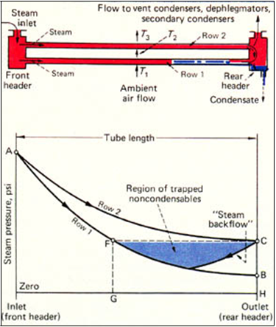
Fig. below illustrates in more detail the trapping of non-condensables in a simple steam condenser having just two rows of tubes and a conventional, non-divided & rear header.
Fig.:- Trapping of non-condensables causes the steam-
condenser problem.
Since the first two row is exposed to thelower, ambient-air temperature, while the second row is contacted by already-heated air, the second row condenses less steam than the first, and therefore has a lower steam-pressure drop. The pressure in the rear header equals the front-header pressure minus the pressure drop in the second row. The pressure in the rear header thus exceeds the pressure at the outlet end of the first row.

Slide 43
So, steam flows into both ends of the first row of tubes, and non-condensables become trapped inside. They cannot flow into the rear header until their pressure equals the rear-header steam pressure (point C in Fig. 3). By then, non-condensables extend for the tube length G-H. Since there is very little steam flowing with the non-condensables, that length of the metal tube becomes cold. Condensate freezes en-route as it flows downward by gravity toward the rear header through this cold section.
Some condenser designs try to cope with this backflow problem by steam "blow-through" to dephlegmators or secondary condensers. The objective is to equalize the steam pressure-drop across each tube row in the main condenser by using larger steam flows, with the remainder of the steam being condensed downstream in the secondary or vent condenser.
Fig. below shows a typical arrangement of main and vent condensers. This design has an open rear header on both condenser sections. If any one of the many variables of turbine exhaust-steam flow, ambient-air temperature or air flow-rate is upset so that the blow-through steam quantity is less than it should be, steam backflow to the first row of the main condenser can occur-which is the steam condenser problem. Similarly, steam backflows to the first row in the open rear headers of the vent condenser, thereby trapping non-condensables once more.

Slide 44
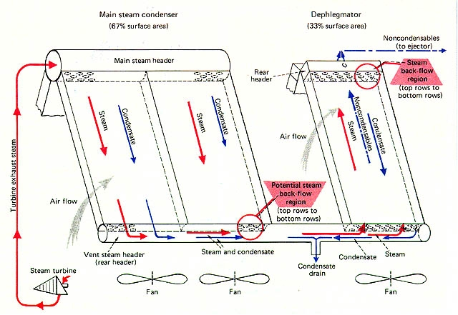
Figure:-Backflow can result when nondivided rear headers are used

Slide 45
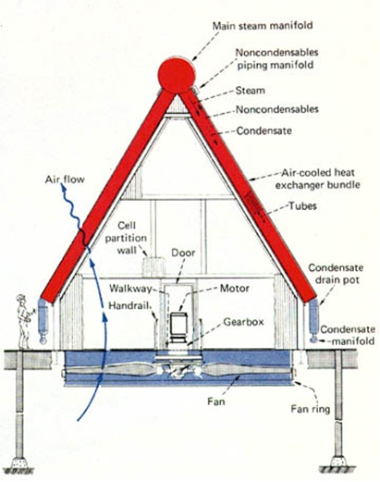
Design and Specification of Air-Cooled Steam Condensers.
A typical A-frame arrangement is shown in the figure below represents the basic flow diagram of a system:-
Figure:- Air-cooled steam condenser of A-frame design

Slide 46
Many evolutionary design changes have been effected as a result of field experience. The main problem plaguing the industry has not been how to condense steam but rather how to prevent a unit from suffering a loss in thermal performance during the summer, and freezing during winter. Today, the mechanics of this steam-condenser problem are understood, fortunately, so that the deficiencies of past designs can be identified and corrected.
A variation to the A-frame configuration is the horizontal bundle arrangement, built with a slight inclination for condensate drain purposes. Here, the vent condenser has co-current flow of steam and condensate rather than counter-current, but the steam condenser problem remains a reality.
The next page’s fig. shows a steam condenser in which each bundle has its own main and vent section. The horizontal tubes have a two-pass arrangement and are interposed so as to minimize steam pressure differences in the rear headers and at the connection to the steam-jet air ejector. The 1-4 mains connect to the 2-3 vents, and the 2-3 mains connect to the 1-4 vents. But since the face velocity of the air flow in the upper regions of the bundle exceeds that at the base, where the vent condenser is located, the steam pressures are not completely equal where the tubes are connected to the common exhaust manifold system. There can thus be a backflow between the vent condenser manifolds serving rows 3 and 4. Also, the first row of the vent condenser is here exposed to the ambient air, rather than being protected from the cold ambient air, as dictated by the low heat content of the low-partial-pressure steam.

Slide 47
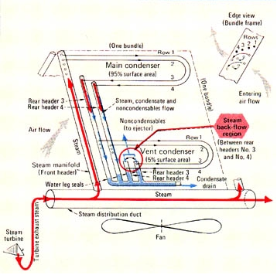
Figure :- Backflow can also occur with common vent manifolding

Slide 48
Other designs employ internal flow-control devices in the front header, such as fixed orifices or flapper valves. This equalizes steam pressure drop among rows, but only at the design operating point. A change in any operating variable changes the flow relationship among rows, and thus the steam pressure drops; the net result again is steam backflow in the undivided rear headers.
Still other designs may vary fin height, fin spacing or finned length from row to row in an attempt to achieve balanced steam-pressure drop between rows and avoid rear header backflow.
Summing up, all of the above methods are undesirable because they can degrade the fluid energy on the steam side, and/or are heat-transfer inefficient on the finned side. They function properly at the design point but run into difficulty when any one of several operating variables (ambient air temperature, air flow, steam flow) is changed.
A better steam condenser is the single-row design shown in Fig. on the next page. As the steam flows through the tubes, it condenses and pushes the non-condensables forward until they reach the rear header. The rear header is purged of non-condensables by means of vent tubes connected to the steam-jet air-ejector system. The vent tubes provide a more effective scavenging action by inducing additional mass flow through the rear header. As a further freeze protection feature, the vent tubes are installed in the warm-air portion of the bundle.
Note that there is no need to balance steam pressure drops because there is only one row, and each tube in the row experiences the same air temperature. The movement of non-condensable gases is always forward because steam backflow does not occur.

Slide 49
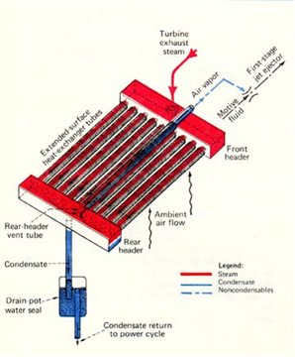
Figure:- Single-row steam condenser avoids backflow problem

Slide 50
To make the single-row concept commercially practical, several such steam condensers must be stacked together, one on top of the other (Fig. on the next page). The internal fluid flows of this multi-row condenser must be completely independent at all times, and the condensate and non-condensables must be withdrawn separately.
Condensate from each row is withdrawn from the rear headers through hydraulic pressure-seals of a water-leg loop design, into a common, heated drain pot. The non-condensables are removed from each row by individual first-stage ejectors; these connect to a common header for flow to the inter-condenser, second-stage ejector and finally the after-condenser. There is positively no passage of steam, condensate or non-condensables among rows inside the condenser at any time.
Many air-condensers which follow the same design as specified above is running efficiently and successfully with relatively less or no accumulation on non-condensables.
The graph on the following page illustrates the operation of a typical divided rear-header vacuum steam condenser in turbine service. Note the wide spread of air temperatures, steam condensing rates and steam pressure drops between the rows.

Slide 51
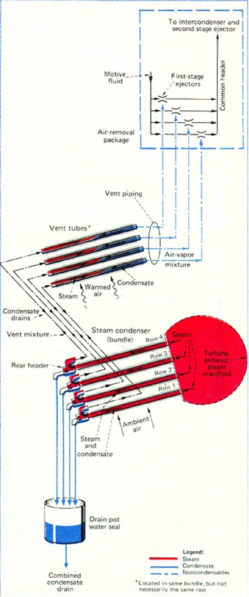
Fig. Commercial systems combine several rows of steam condensers

Slide 52
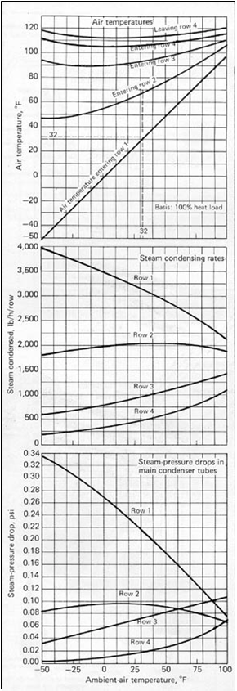
Graph depicting operating characteristics of an air-cooled steam condenser

Slide 53
Case study for installation of Indirect Air Cooling System with Direct Contact Condenser unit at P&BS-1 and PP-2
Case Study for P&BS-1 :-
After collecting the specifications, requirements & load of P&BS-1, we carried out a case study for the savings of capital and more importantly the most valuable natural resource i.e. water, which is as presented here:-
Highlights :-
There is no Cooling Tower(CT) installed at P&BS-1.
There are total three Turbo Generators(TGs) at P&BS-1; two of 12MW capacity each and one of 15MW capacity.
There are total 9 Turbo Blowers(TGs) of total capacity 114.439 which is distributed as :-
TB-4,5 -------2nos.---------10MW*2----- -------=20MW
TB-6 --------1no. ----------12MW -------------=12MW
TB-7,8,9,10---4nos.-------12.5MW*2----------=50MW
TB-11--------- 1no.---------16.09MW-----------=16.09MW
TB-12----------1no.---------16.349MW----------=16.349MW
TOTAL= 114.439MW
Specific steam consumption for 15MW TG is 4.5Ton/Hr. per MW power and specific steam consumption for the other two TGs and the 9 TBs is 5.5Ton/Hr. per MW power.
Cooling water required to be circulated for condensing 1 ton of steam per hour is 55M³ .
Cost of 1M³ water is Rupees 60.
Cost of electricity is Rupees 7 per unit( KWH) .

Slide 54
Calculation :-
Steam consumption :-
For 15MW TG = 15MW *4.5Ton/MWH = 67.5Ton/Hr.
For other TGs &TBs
=150.44MW*5.5Ton/MWH=894.9145Ton/Hr.
total steam consumption = 894.9145Ton/Hr.
Make up Cooling Water consumption :-
Cooling water circulated
= 55*827.4245
= 49220.29M³/Hr.
Cooling water being consumed as make up water
= 3% of 429220.29
= 1476.61M³/Hr.
= 1476.615*24*365 M³/year
= 12935094.18M³/year
Water saved per year = 12.935 million M³ !!!
Total cost of water saved
= RS. 12935094.18*60 per year
= RS. 77,6105651 per year
Power requirement of proposed air-cooled condenser unit
= 11097KWhr
Cost of electricity consumed by air-cooled condenser unit
= RS. 11097*7 per hour
= RS. 11097*7*24 per day
= RS. 11097*7*24*365 per year
= RS. 68,0468040 per year
Total savings per year on installation of Air-cooled condenser at P&BS-1
= RS.(776105651-680468040)
= RS. 9,5637611
= 9.56 crores!

Slide 55
Case study for PP-2 :-
Highlights :-
There is provision of Cooling Tower(CT) at PP-2, whose specifications are mentioned below :-
Four HT Pumps are there , each having the following specification :-
Voltage : 6.6 KV
Actual Current : 55 amp.
Actuated with a motor of 540KW capacity.
Five cooling fans are there, each having the following specification:-
Voltage : 400V
Actual current : 110amp.
Actuated with a motor of 74KW capacity.
PP-2 is dedicated to power generation only with a gross capacity of 74MW.
There are total three Turbo Generators , one of 14MW capacity and the other two of 30MW capacity each.
The specific steam consumption for PP-2 is 5Ton/Hr. per MW.
Cooling water required to be circulated for condensing 1 Ton steam per hour is 50M^{3.}
Cost of 1M³ water is Rupees 60.
Cost of electricity is Rupees 7 per unit( KWH) .

Slide 56
Calculation :-
Steam consumption :-
total steam consumption = 74*5 Ton/Hr.
= 370Ton/Hr.
Make up cooling water consumption(i.e. water saved):-
Cooling water circulated for condensing steam
= 370*50 M³/Hr.
= 18500 M³/Hr.
Cooling water bring consumed as make up water
= 3% of 18500M³/Hr.
= 555M³/Hr.
= 555*24*365 M³/Hr.
= 4861800 M³/Hr.
Therefore, total water saved per year = 4861800 M³/Hr. !!!
Total cost of water saved
= RS. 4861800*60
= RS.291708000 /year
Cooling Tower power Consumption:-
energy consumption per hour per pump
= sq.rt of 3*6.6*55*cos(.85)
= 414.95KWH
Total energy consumption for four pumps
= 1659.816543 KWH
Energy consumption per hour per fan
= sq.rt of 3*.44*110*cos(.85)
= 55.33KWH

Slide 57
Total energy consumption for four fans
= 276.64 KWH
Total energy consumption for CT per hour
= 1936.45 KWH
Money saved by avoiding cooling tower
= RS.1936.45*24*365*7
= RS. 118743275.50
ACC(Air Cooled Condenser)power consumption:-
air cooled condenser energy consumption
= 4587.67 KWH
Money required for ACC
=RS. 4587.67*24*365*7
=RS. 281316257.90
Therefore, total money saved on replacing Cooling Tower with Air-cooled Condensing Unit for PP-2
= cost of makeup water saved- cost of power consumed by ACC+ cost of power saved by avoiding CT
= RS. (291708000-281316257.90+118743275.5)
= RS. 129135017.60
= 12.9 crores !
Result of case study :-
The study reveals that for P&BS-1 the total saving of water is 12.9 million M³ and that of capital is 95.6 million rupees per year and for PP-2 the total saving of water is 4.8 million M³ and that of capital is 129.1 million rupees.

Slide 58
Guidelines to avoid Design Deficiencies
The purchaser has many options to consider and many questions to answer in preparing the inquiry specification to be presented to manufacturers of air-cooled steam condensers. First, the scope of the system package to be purchased must be decided, and the more important specification details established.
An air-cooled steam condenser system starts at the turbine exhaust flange. It includes all of the equipment necessary to condense the steam and return the condensate to the boiler feed-water piping. These items are:
Air-cooled steam condenser tower(item1).
Air-flow control equipment(item2).
Wind and/or cell-partition walls(item3).
Steam-bypass heating system(item4).
Air removal equipment(item5).
Condensate storage tank(item6).
Condensate pumps(item7).
Steam ducts and expansion joints(item8).
Condensate drain and air-removal piping(item9).
Instrumentation, controls and alarms(item10).
Pressure-relief device for protection of steam- turbine exhaust casing(item11).
Steam-duct condensate drain system(item12).
The purchaser has the option of buying this complete system package, or requesting only a portion of it.

Slide 59
The basic air-cooled steam condenser (Item 1) includes the bundles, steam distribution manifold, fans, motors, gear boxes and supporting steel. In large installations, the cost of the tower structure supporting the condenser bundles can be a substantial portion of the total cost. The structure's design specifications for wind load, snow load, live load and seismic requirements should be carefully chosen. Generally, grade-mounted towers cost less than roof-mounted ones.
Limitations on plan dimensions must be made clear in the inquiry specification. Heat sources located close to the proposed tower and discharging into the atmosphere must be identified. The prevailing wind directions define the proper location and orientation of the tower with respect to other large structures and heat sources. Summer winds are important in the consideration of thermal performance, and winter winds in prescribing freeze-protection measures. Noise limitations should also be stated, since lower fan noise generally requires lower tip speed, more fan blades and possibly wider blades.
The purchaser should specify whether the thermal performance guarantees are to be based on steam pressure measured at the turbine exhaust flange, or at the steam manifold inlet at the condenser. Other options are an all-welded system to reduce the potential for air leaks into the condenser, and the use of extruded aluminium fins (Fig. on next page), which provide longer trouble-free operation than embedded or wrap-on fins (these are prone to galvanic corrosion because of their bimetallic tube-to-fin interface).

Slide 60
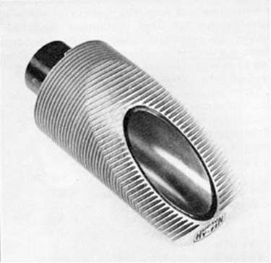
Figure :- Extended heat-exchanger surface consists of extruded aluminium fins over a carbon-steel tube.
Airflow control equipment for freeze protection (Item 2), though an integral part of the engineered package supplied by the manufacturer, nevertheless reflects the purchaser's preferences and needs. Consideration should be given to variable-pitch fans, air-flow control louvers, steam isolating valves and two-speed motors. The extra price of electric starters needed for two-speed motors should be included.

Slide 61
Wind walls (Item 3) are sometimes necessary to protect the bundles from wind gusts that can upset equilibrium operating conditions and at times cause freezing in some remote parts of the tower. Partition walls between fan cells isolate operating cells from non-operating ones. Without partition walls, a non-operating fan would induce bypass of air intended for the bundles.
Depending upon the minimum design ambient-air temperature, the type of turbine, and the type of plant operation, it may be economic to provide a steam-bypass heating system for cold-weather start-up (Item 4). This would operate directly off the boiler, requiring both a steam pressure-reducing station and a de-superheating station, with steam flow exhausting directly into the main steam duct. Part of the condenser heating steam during startup would be supplied by the turbine exhaust, and the remainder from this bypass system. Alternatively, large steam-isolating valves can be installed, to supply condenser sections sequentially, with steam flows only from the turbine exhaust.
The equipment extracting non-condensables from the system (Item 5) consists of the hogging ejector and the operating ejectors. During start-up, the hogging ejector removes air from inside the, turbine, steam ducts, steam manifolds and bundles. It reduces the air pressure within the system from atmospheric to about 10 mm of Hg absolute in a time period specified by the purchaser.

Slide 62
For the usual full-vacuum steam condenser, a two-stage operating ejector system complete with condensers is normally provided, with or without standby. Its capacity is generally specified by the purchaser in accord with the Heat Exchange Institute Standards for steam surface condensers. Some purchasers add a safety allowance by doubling the venting capacity recommended in the standard. The costliest parts of the ejector package arc the inter- and after-condensers, which are shell-and-tube construction. These can be smaller and lower-cost if a separate, colder, cooling-water supply is used instead of the hot condensate.
Motor-operated vacuum pumps can also be chosen; these adapt readily to automated remote operations. The purchaser's inquiry specification should establish, for the air removal package, these points: choice of Steam-jet air ejector or motor-driven vacuum pump; motive steam pressure and temperature; hogging-ejector minimum operating time; evacuating capacity of operating ejector package (compared with Standards recommendation); standby requirements for condensers and ejectors; and condenser cooling-water supply source and temperature.
The condensate storage tank (Item 6) is generally sized for a 5- to 10-min operating storage capacity. Total tank size exceeds this operating storage capacity by an amount representing the total condensate held in the drain pots and drain piping.

Slide 63
The condensate pumps (Item 7) are generally either two 100%-size units or three 50%-size units, to provide standby capability for emergency situations. The system generally has a very low net positive suction head availability so the pumps should be installed close to the condensate storage tank. The pump's total dynamic head must be sufficient to deliver the condensate into the purchaser's boiler feed-water system.
The steam duct system (Item 8) connects the condenser inlet-steam manifold to the turbine exhaust flange. It includes expansion joints, anchor points, elbows, turning vanes and duct supports. The purchaser should specify the preferred corrosion allowance for the manifolds and steam ducts since this affects system cost. Economics dictate the steam-duct diameter. The smaller the size, the greater the steam pressure drop and the greater the required heat- transfer-surface area in the condenser. The trade-off lies between heat-transfer-surface cost and steam-duct cost. (The steam-turbine thermal performance and power output depend on condenser pressure at the turbine exhaust flange, not on the steam pressure at the inlet to the bundles.) Past evaluations for full-vacuum systems have generally indicated an optimum steam velocity of about 200 ft/s at 6 in. Hg absolute steam pressure.
The condensate drain piping and manifold system (Item 9) starts at the bottom of the bundles and ends at the condensate storage tank. The air-removal piping and manifold system starts at the top of the bundles and terminates at the steam-jet air ejector package.

Slide 64
The instrumentation package (Item 10) includes such devices as temperature indicators and thermocouples; pressure indicators and transducers; vibration-pickup transducers; liquid-level devices; status lights; annunciator panel; and recorders. The controls might include storage-tank condensate level; low-flow condensate pump bypass; fan pitch control; air louver control; steam-valve control; and fan-motor control. These controls can be computerized from start-up to shutdown, to maximize the turbine's thermal efficiency and power output, minimize the auxiliary-fan power consumption, and protect the condenser from freezing.
In the event of complete electric-power failure to the steam-condenser fans, an atmospheric-relief diaphragm safety device (Item 11) should be installed in the turbine exhaust system, to protect the turbine exhaust hood from excessive steam pressure. This diaphragm generally ruptures and relieves at about 5 psi for turbines designed for full-vacuum service. Some turbine manufacturers provide such a device on the exhaust hood; if not, the purchaser can provide external protection by installing an atmospheric relief valve(s) in the exhaust steam duct close to the turbine.
The large steam duct connecting the turbine exhaust to the steam-condenser manifold condenses a considerable quantity of steam during a cold startup, while the metal temperature rises to some equilibrium level. This condensate must be drained to an appropriate low point in the duct system and then pumped or ejected (Item 12) into the condensate storage tank.

Slide 65
Thermal Specification & Cold Climate Considerations.
The more-important thermal data that the manufacturer requires from the purchaser for the design and optimization of the steam condenser are:
1. Exhaust steam flowrate.
2. Exhaust steam enthalpy.
3. Design exhaust pressure.
4. Design ambient-air temperature.
5. Maximum ambient-air temperature.
6. Minimum ambient-air temperature.
7. Lowest optimum turbine-exhaust pressure.
8. Highest permissible turbine-exhaust pressure.
9. Economic optimization of fan power usage.
The first three items define the full-load fluid properties entering the air-cooled steam condenser. If there are any condensate drains or other waste-heat streams entering the condenser, these must of course be detailed.
The design exhaust pressure (Item 3) is measured at the turbine exhaust flange if the manufacturer supplies all of the steam duct from turbine to condenser. When the purchaser supplies the steam duct, the pressure is generally measured at the connecting point of the purchaser's duct to the manufacturer's steam manifold.

Slide 66
The design exhaust pressure is the pressure that exists simultaneously with the design ambient-air temperature (Item 4). Since the heat-transfer driving force of an air-cooled steam condenser decreases with a rising ambient-air temperature, the unit's pressure and temperature design points should be established for the relatively adverse operating conditions. This should be the highest exhaust pressure that can be routinely tolerated by the turbine during a hot summer day. The higher the design exhaust pressure and the lower its companion ambient-air temperature specification, the smaller and less costly the steam condenser.
The upper limit for the design exhaust pressure is set by economic or turbine-mechanical considerations. The higher the value, the lower the horsepower available from the turbine to drive the electric generator, the compressor or the pump. There will be plant constraints or losses if horsepower falls below a prescribed minimum. Also, the steam-turbine manufacturer may have a turbine-exhaust-pressure limitation for mechanical and metallurgical reasons; typically, the limit may be 5 or 6 in. Hg absolute for a vacuum turbine, which must not be exceeded during normal full-load operation.
The companion design ambient-air temperature (Item 4) can range from 60 to 110°F. It should be selected on the basis of economics; the figure can, but does not always, turn out to be an annual average, a summer peak, or the temperature that is not exceeded more than 5% of the time.

Slide 67
The economic design ambient-air temperature is determined by selecting several potential values, sizing the steam condensers, estimating the capital cost of each, and then calculating their average annual performance. The higher-temperature cases will have larger steam condensers of higher capital cost, which can pay for themselves only by yielding a larger plant output. When the higher annual capital cost for a larger condenser just equals its annual savings, the corresponding ambient-air temperature becomes the economic optimum and establishes the condenser size.
When time restraints do not permit such a comprehensive economic study, the alternative is to select the lowest ambient-air temperature that experience prudently allows. The purchaser must be aware that performance will suffer when that temperature is exceeded (even if for only a few hours a year), and the turbine output may have to be cut back somewhat. The dollar penalty of such cutbacks must be balanced against the higher capital cost of a greater-capacity condensing system that could avoid cutbacks.
The maximum ambient-air temperature (Item 5) establishes the maximum turbine-exhaust pressure at full load for a given condenser. The minimum ambient-air temperature specification (Item 6) determines the type and degree of freeze protection.
The lowest optimum turbine-exhaust operating pressure (Item 7) is a characteristic of the turbine's particular design and construction. Below a given exhaust pressure, the turbine's last-stage leaving losses become so large as to reduce the turbine shaft output. This specification

Slide 68
comes from the turbine manufacturer. Similarly, the highest permissible turbine-exhaust operating pressure (Item 8) is set by the turbine maker. This pressure cannot be exceeded during the maximum ambient-air temperature (Item 5) even if it requires reducing the throttle steam flow to the turbine.
The purchaser normally is not concerned with the internal steam-pressure drop of the air-cooled condenser, Such pressure drop is optimized by the manufacturer, taking into account the performance of the steam-jet air ejector and the specification for the lowest optimum turbine-exhaust pressure (Item 7). Purchasers who specify pressure drop can in fact limit the condenser designer's choice of tube diameter and length, and thus prevent the optimum capital-cost selection.
The steam condenser manufacturer optimizes designs by balancing the cost of fan power (Item 9) against the capital cost of heat-transfer surface. The cost of the purchaser's electric power, both demand and energy charges, must be known. This should reflect the actual increase in the annual utility power bill for each brake horsepower of fan power. It should be priced on the basis of the lowest-cost increment on the utility's rate schedule applicable to the purchaser.
This annual power cost must be converted into a lifetime cost figure, by capitalizing it to reflect the present value of all monies to be paid for power over the life of the plant. Adding this capitalized power cost to the equipment capital cost gives the total owning and operating cost of the steam condensing system. Such power cost data submitted by the purchaser allows the manufacturer to trade off between heat-transfer surface and fan power, to provide the purchaser with the most economic condenser design

Slide 69
Cold-Climate Considerations
The factors involved in warm-up, start-up and freeze protection during cold weather are:
1. Minimum-available steam flow.
2. Bypass steam flow.
3. Air flow control.
4. Ambient air preheat.
In general, the lower the minimum ambient-air temperature, the more costly the system equipment. Similarly, the smaller the minimum-available steam flow from the turbine (for immediate warm-up of the condenser surfaces), the more costly the system.
A steam turbine must be started with steam flow to the throttle not exceeding the maximum rate prescribed by the turbine manufacturer. Turbines require careful start-up to protect the rotors and stators from thermal distortions, which can occur as a result of too-fast loading that produces large metal-temperature gradients.
While a slow start-up is desirable for the turbine, it is, however, undesirable for the condenser. Metal surfaces in the steam condenser must be brought up to a temperature above freezing quickly, to prevent condensate from freezing in some remote part of the tower.
There are several remedies if the immediate, minimum-available steam flow to the air-cooled condenser is too low for safe start-up (considering the minimum-controllable airflow and natural-draft effects). One is to isolate the condenser into several sections by means of large steam valves, for sequential start-up.

Slide 70
Another is to increase the steam available to the condenser by bringing in live bypass steam from the boiler. An occasionally used method is to heat the incoming ambient air with open-flame torches that burn natural gas or fuel oil.
Once the metal of the air-cooled steam condenser is heated, the next hurdle is to condense steam safely on a continuous and controlled basis. Two independent variables that can upset equilibrium conditions are ambient-air temperature and wind. Another upsetting factor is a decreasing exhaust-steam flow rate. Controlling airflow through the bundles is the only technique available to counterbalance these effects.
There are several means for achieving airflow control. The selection depends upon the severity of the cold weather and the minimum-available steam flow. Some of the more common means are listed below, in order of increasing control capability and cost:-
Fan-blade Pitch | Motor Speed | Other | Air Flow
Fixed | Single | ----------------- | S% to 100%
Fixed | Tow | ----------------- | S% or 50% or 100%
Variable | Single | ----------------- | S% to 100%
Fixed | Single | Louvers | S% to 100%
Variable | Single | Valves | S% to 100%
The air flow quantity S% refers to a "small" amount as induced by natural draft, wind effects, blade eddies, or leakages through louvers. Even this small amount can be critical during extremely cold weather, when the heat-transfer driving force becomes very large and only a very small air flow is needed to maintain the desired thermal equilibrium. However small the air flow, it must be operator controlled at all times, for example by using variable-pitch fans that can be set into negative pitch to counteract natural draft when necessary.

Slide 71
Check points for safe design.
In the review of alternative steam-condenser proposals, the purchaser should question the manufacturers to ensure that their designs do not trap non-condensables under any operating conditions, and thus are not freeze-prone. Typical questions and concerns include:-
Are there open rear headers or common rear manifolds that connect different rows of tubes together? Check both the main condenser bundles (or tubes) and the vent condenser bundles (or tubes).
If the answer is yes, ask the manufacturer to provide steam flow-rates, steam condensing rates and steam pressure drops in each row of the main and vent condensers (for a typical bundle), for the full range of operating steam loads, ambient-air temperatures and air flow velocities. Find out how the manufacturer maintains identical steam pressures in the rear header (or rear manifold) for each row over the full operating range, to avoid steam backflow.
How does the total travel length of purged non-condensables compare among units? This is the longest distance non-condensables must travel through the rear header of the main condenser before reaching the entrance of the vent condenser tubes. The longer this travel length, the more difficult it is to purge the main condenser tubes that are farthest away from the vent condenser tubes.
Do the vent tubes contact cold ambient air, or are they installed in a heated section of the bundle where they cannot freeze? Tubes in the vent condenser carry some steam along with the non-condensables. Since the steam partial pressure is low, heat content is low

Slide 72
How are the condensate-drain water-seal loops protected from freezing?
Can the condenser function with all fans off for indefinite periods, without steam backflow?
What is the degree of steam flow upset that occurs in operating cells when the fan of an adjacent cell is turned off? The non-operating cell will have a higher steam pressure in its rear headers. How will this higher pressure affect the main and vent condensers of the adjacent operating cells, and what does the manufacturer recommend to relieve steam backflow?
Does the vent section of the condenser have a separate set of fans from the main condenser? If so, is it necessary to run the vent fans in some prescribed manner in relation to the main condenser fans? What happens when the vent condenser fans are operated differently from the prescribed speed regimen?
Where will the major components, such as the bundles and the fans, be manufactured, and, if job shops are used, how is quality control maintained?

Slide 73
Conclusion
Our study has lead us to the conclusion that Air-cooled Condenser would surely emerge as a boon for various Power Plants in India, seeing the day-by-day increasing shortage of water. In the coming days, water would become the root factor in deciding not only the profit of a Power Plant in India, but also its existence and prevalence . Under such a situation Air-cooled Condenser would emerge as a savior, which would play a vital role by saving a huge amount of make up cooling water. Not only this, the installation of proper Air-cooled condenser with proper design, considering the local environment, would help to avoid condenser problems like backflow and trapping of non-condensables more efficiently ; it would save a good amount of money too.
Our study reveals that , Indirect Air Cooling System with Direct Contact Condenser is best suited to be installed at P&BS-1 and PP-2 of SAIL-BSP, considering the local environment. The installation of the same would result in saving 12.9 million M³ of water per year at P&BS-1 and 4.86 million M³ per year at PP-2; and would fetch a saving of 95.6 million rupees per year at P&BS-1 and 12.9 million rupees at PP-2.

Slide 74
References
Engineering thermodynamics by P.K. Nag.
www.google.com
www.howstufworks.com
Pravah Training Manual of P&BS, SAIL-BSP.
Cost Reduction Handbook of SAIL-BSP
Hudson Products Corporation Houston, Texas
www.icl.tech.com

